Slide 1
Identifying DND races
By: Jim Rehnqvist

Slide 2
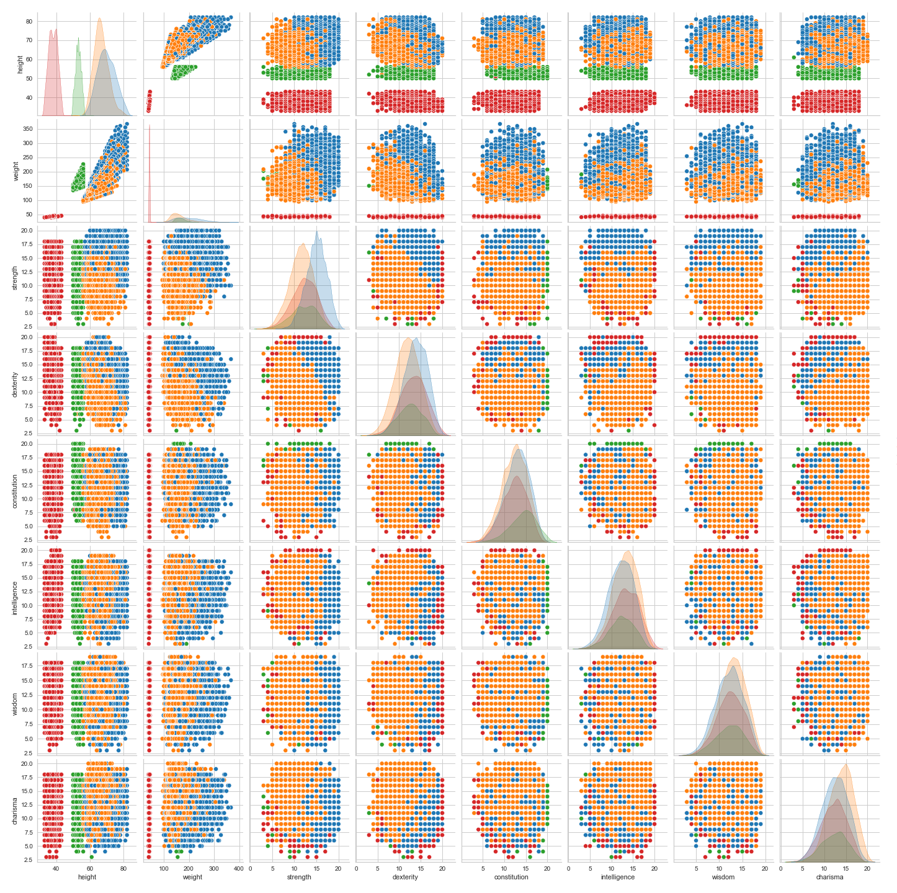
The Grops

Slide 3
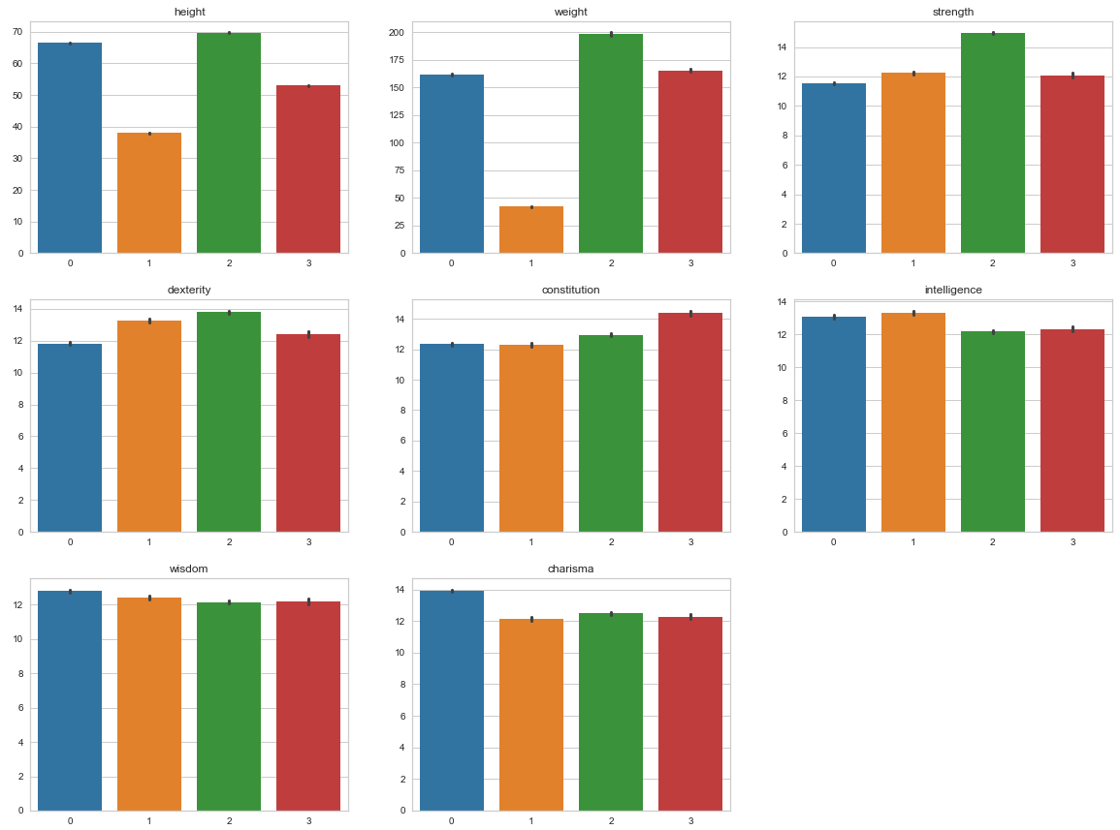
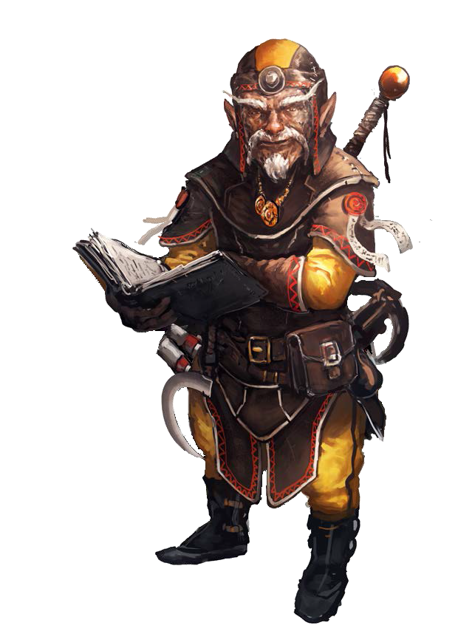
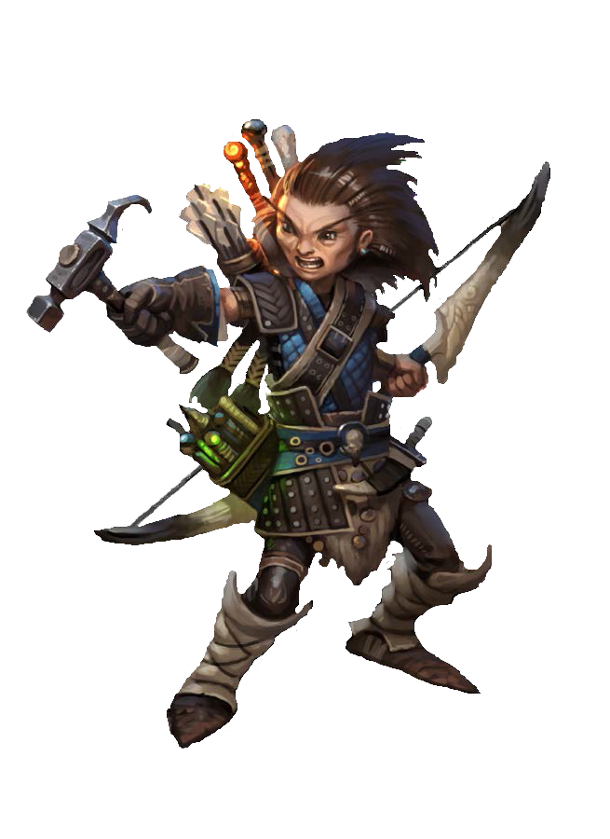
The Grops
Small Boys:
Gnome
Halfling

Slide 4
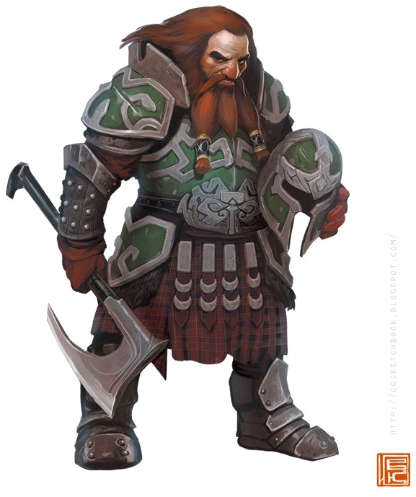
The Grops
Small Boys:
Gnome
Halfling
The Compact:
Dwarf

Slide 5
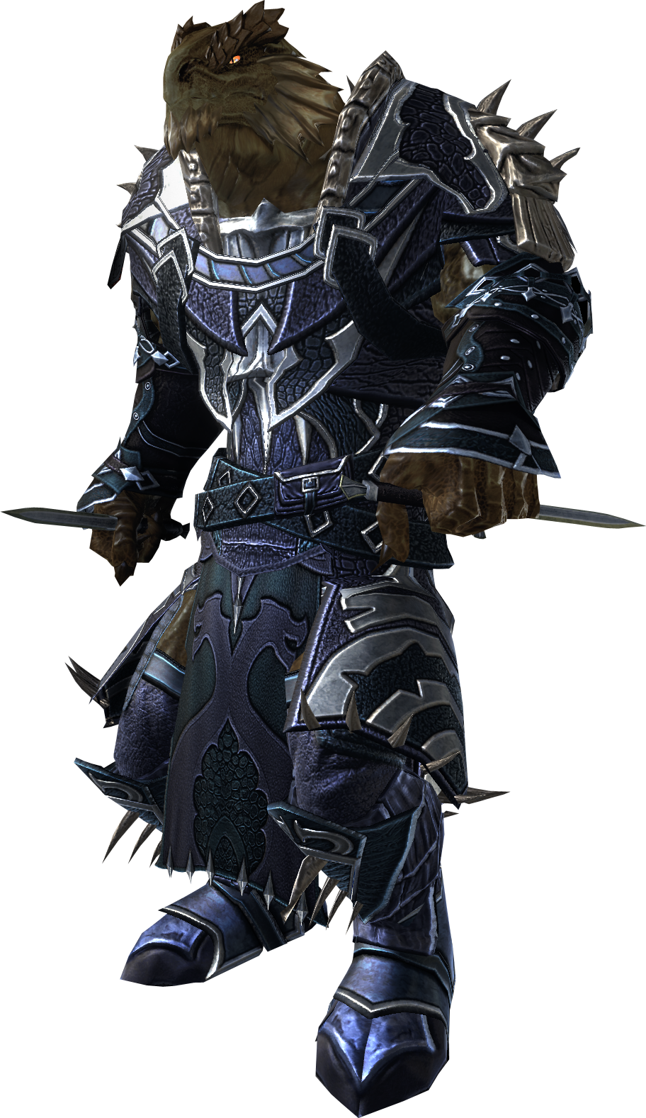
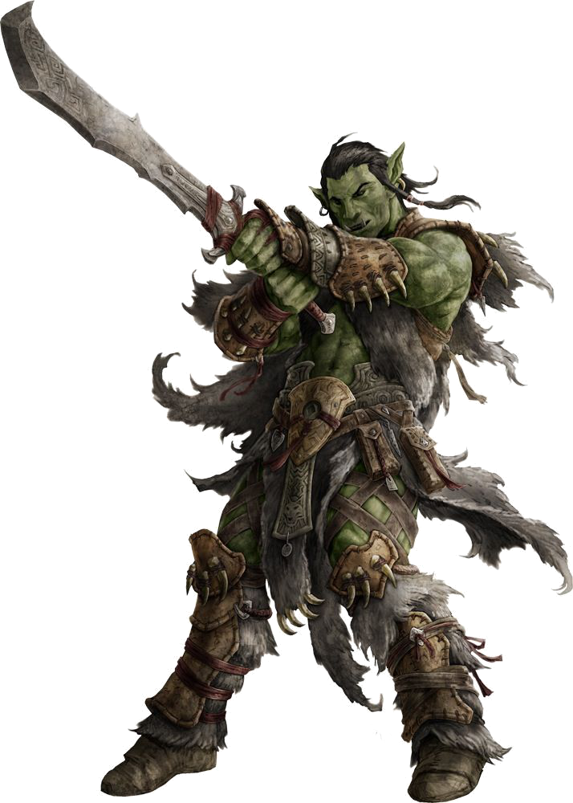
The Grops
Small Boys:
Gnome
Halfling
The Compact:
Dwarf
Big Boys:
Dragonborn
Half-Orc

Slide 6
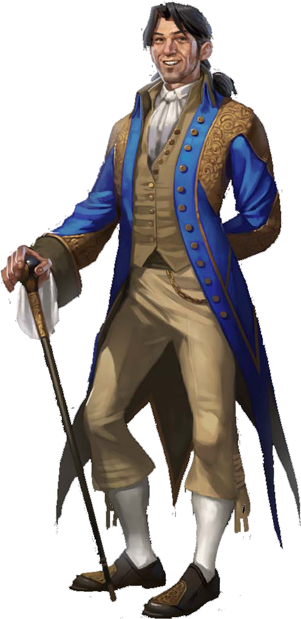
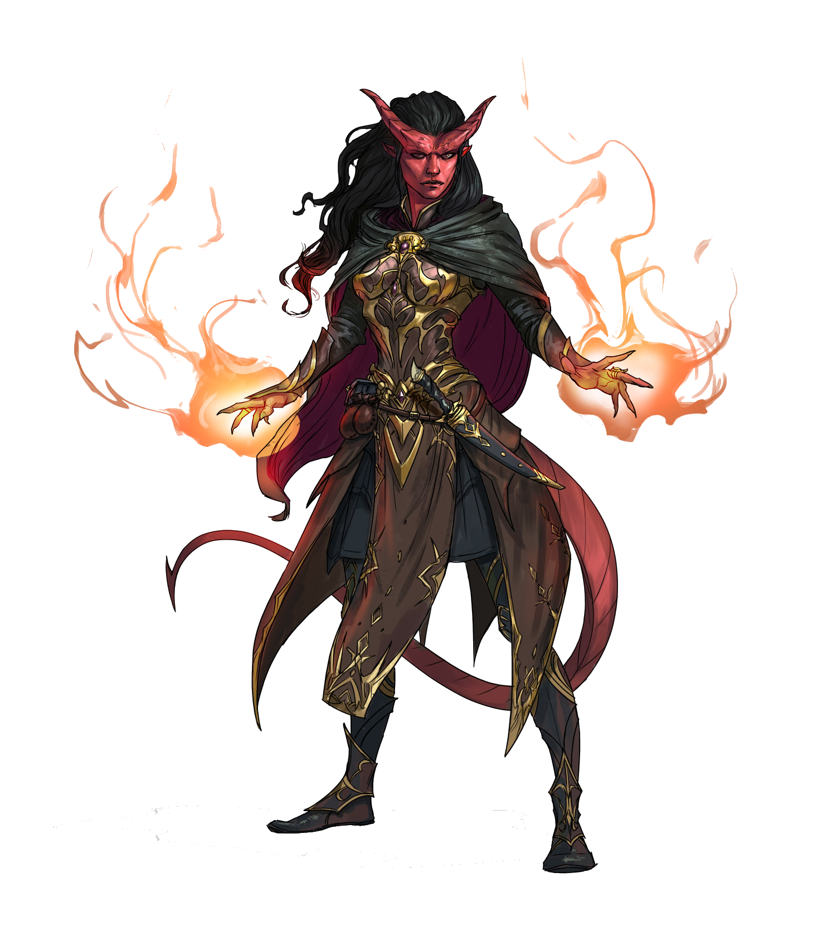
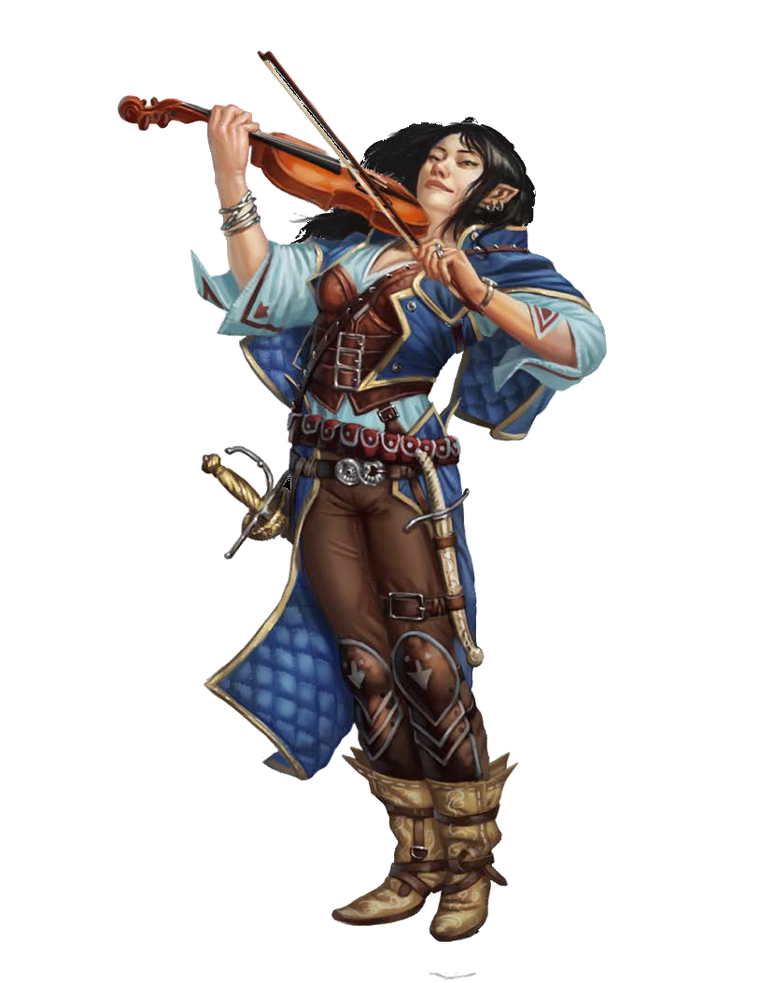
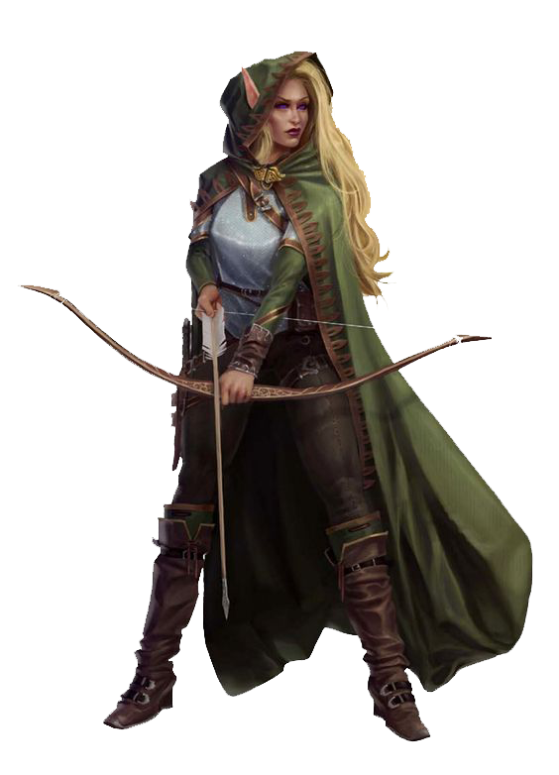
The Grops
Small Boys:
Gnome
Halfling
The Compact:
Dwarf
Big Boys:
Dragonborn
Half-Orc
The Average:
Elf
Half-Elf
Tiefling
Human

